Slide 1
Homework 1
Data Wrangling with Baltimore City 911 Report Data
By
Siddhidhatri Rohith Reddy J (LO55859)

Slide 2
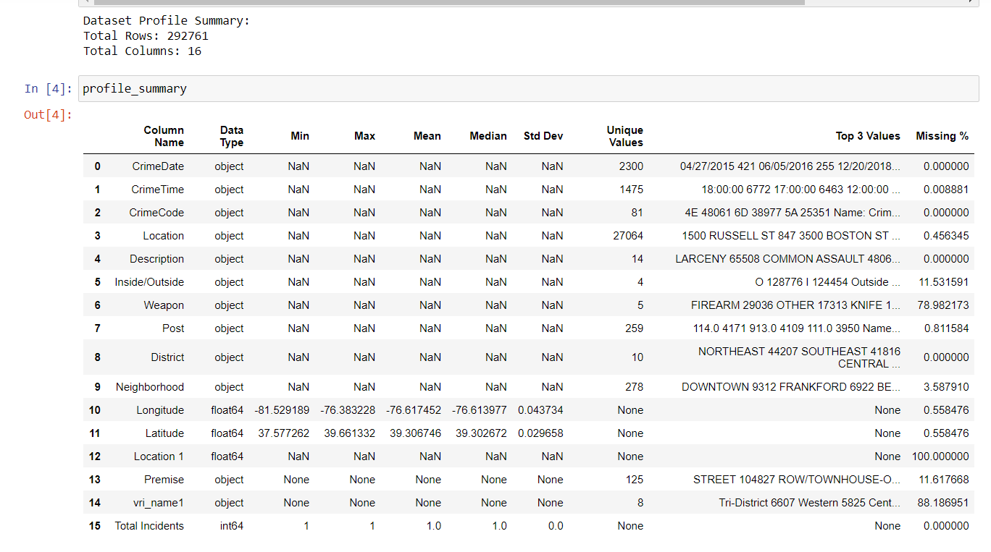
Profile Table

Slide 3
Observations from Profile table
1.Missing Values:
When Observing the missing % column, we can remove rows which have more than 50%. Columns like 'Location 1', 'vri_name1' and 'Weapon'.
2.Datatypes:
The data types of the columns seem appropriate. Categorical columns like "CrimeDate," "CrimeTime," "CrimeCode," "Description," "Inside/Outside," "Weapon," "District," "Neighborhood," "Premise," and "vri_name1" are correctly identified as objects, while numeric columns like "Longitude," "Latitude," and "Total Incidents" have the expected data types.
The "CrimeTime" column is of data type object, which might be expected to be in time format. It also has a very small percentage of missing values (approximately 0.00888%).
3.Total Incidents column:
The "Total Incidents" column appears to have constant values (all 1s) and a data type of int64. This might be useful for counting total incidents in plotting.
4.Post and Neighborhood columns:
Post and Neighborhood: The "Post" and "Neighborhood" columns have a significant number of unique values, indicating diversity in these categories.
5.Longitude and Latitude Ranges:
The "Longitude" column has a minimum value of approximately -81.53 and a maximum value of -76.38, while the "Latitude" column ranges from approximately 37.58 to 39.66. These values seem to be within the expected range for Baltimore, MD.

Slide 4
Preprocessing Steps Implemented
Dropped columns like 'Location 1', 'vri_name1', 'Weapon' that are not necessary.
Converted Data Types:
CrimeDate, CrimeTime : datetime64
Longitude, Latitude: Float64
Description, Inside/Outside, District: Category
Remaining to string data types
Dropped rows with Null values. There are only 40,000 rows of missing values in string columns, dropping them will not affect the DataFrame.

Slide 5
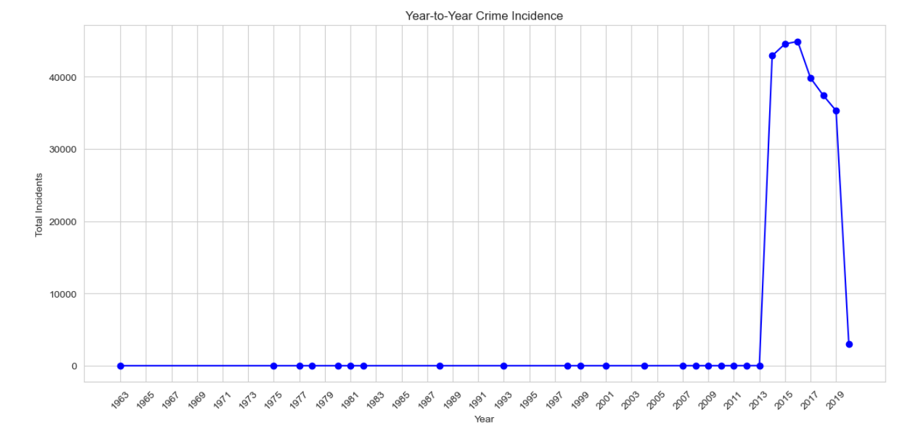
Data Analysis:
Year to Year Crime Incidents
Most crime Incidents occured in 2016. Years 2015 and 2014 takes Second and Third Places.

Slide 6
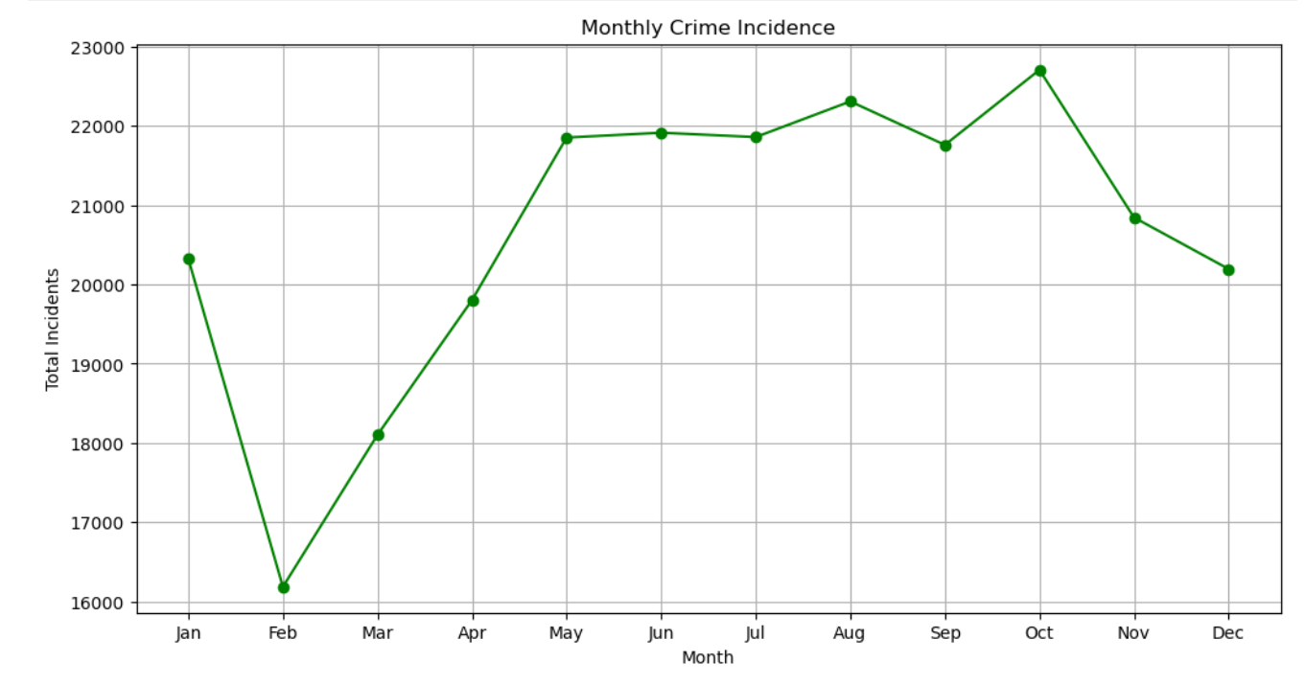
2. Monthly Crime Incidents
Most Crime Incidents happened in month October and least came in February. My assumption here is some of the criminals associated in months Oct, Nov, Dec, Jan have been caught or arrested, So there is a dip in incidents in Feb month.

Slide 7
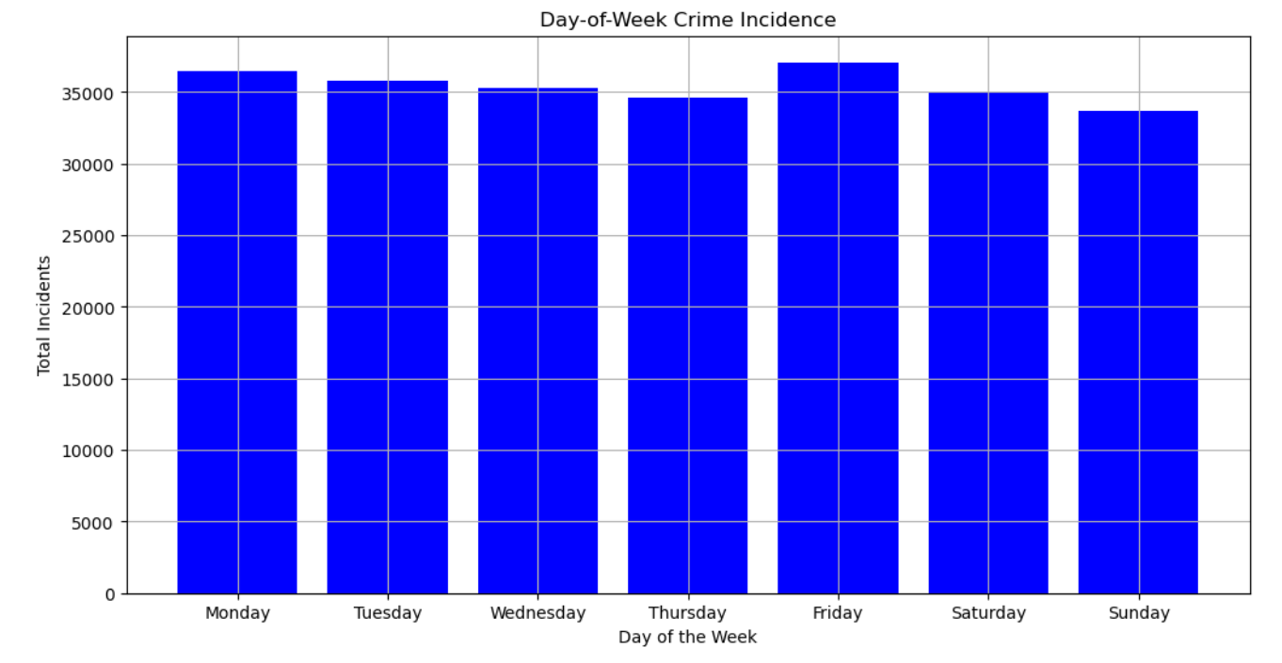
3. Weekly Crime Incidents
Most Incidents happened on Friday. My assumption here is criminals plan on friday mostly because they needed money spend on weekend or most government offices are closed on Saturday and Sunday.

Slide 8
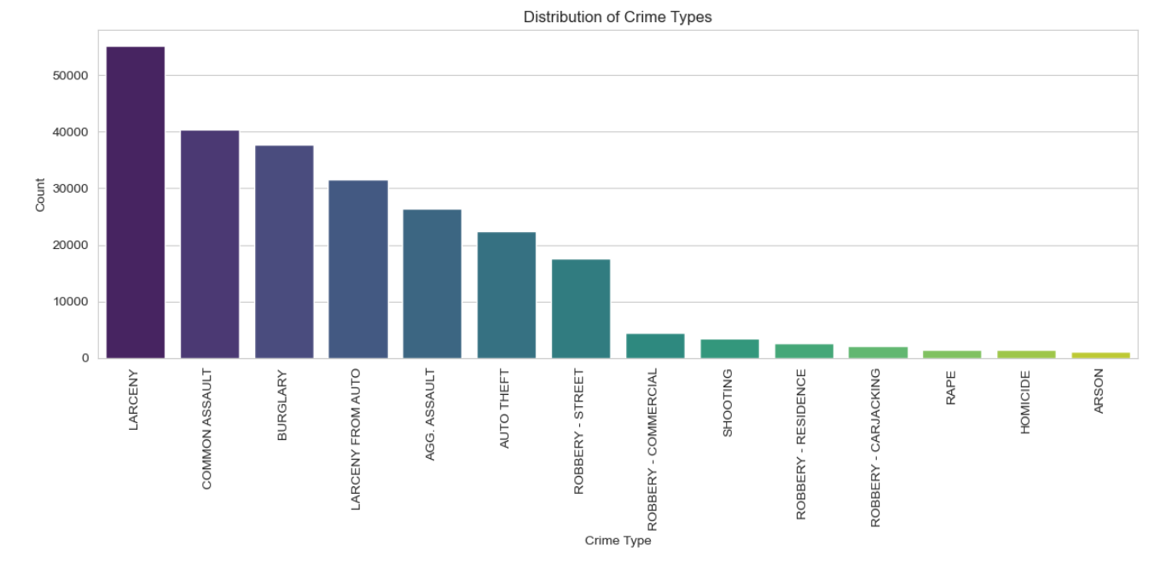
4. Distribution of Crime Types
Most commonly crime type is Larceny and least is Arson. My assumption here is Larceny involves various theft-related activities, which can include pickpocketing, bicycle theft, and theft from vehicles which are relatively small when compared to other crime types and most of the times, these go unreported.

Slide 9
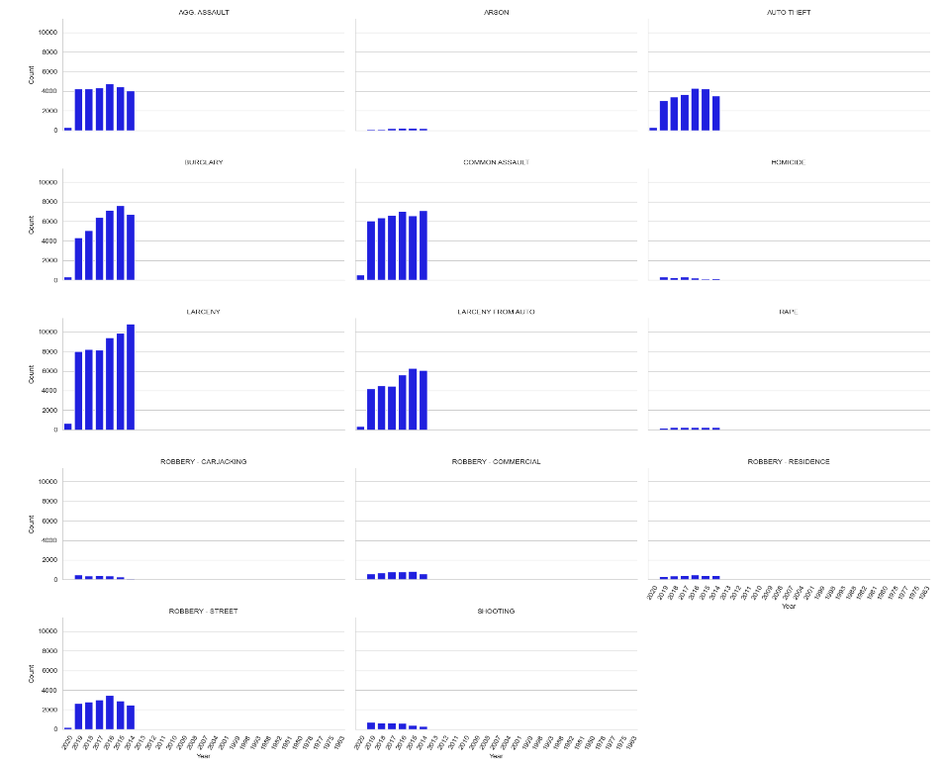
Crime Type year wise analysis

Slide 10
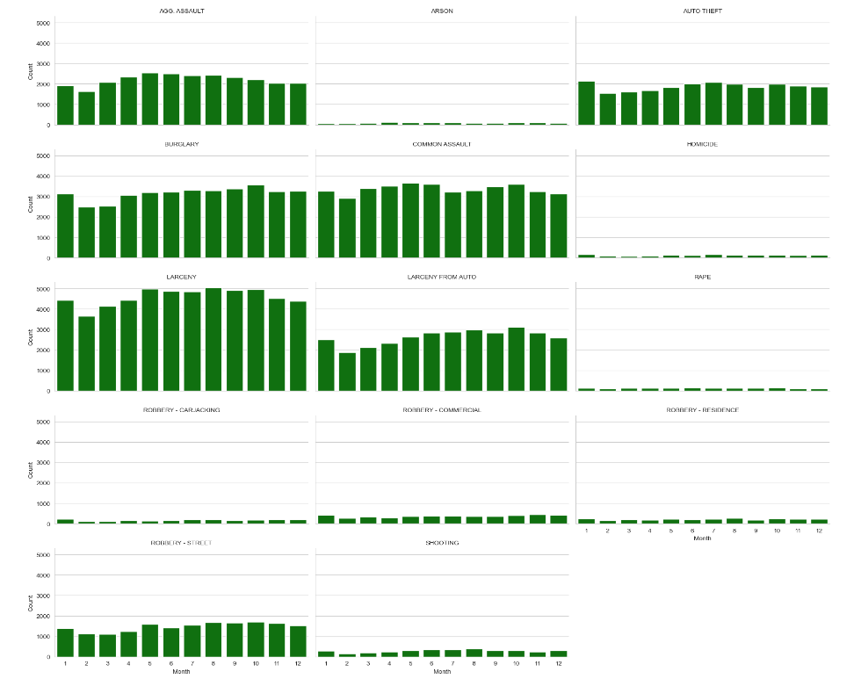
Crime Type month wise analysis

Slide 11
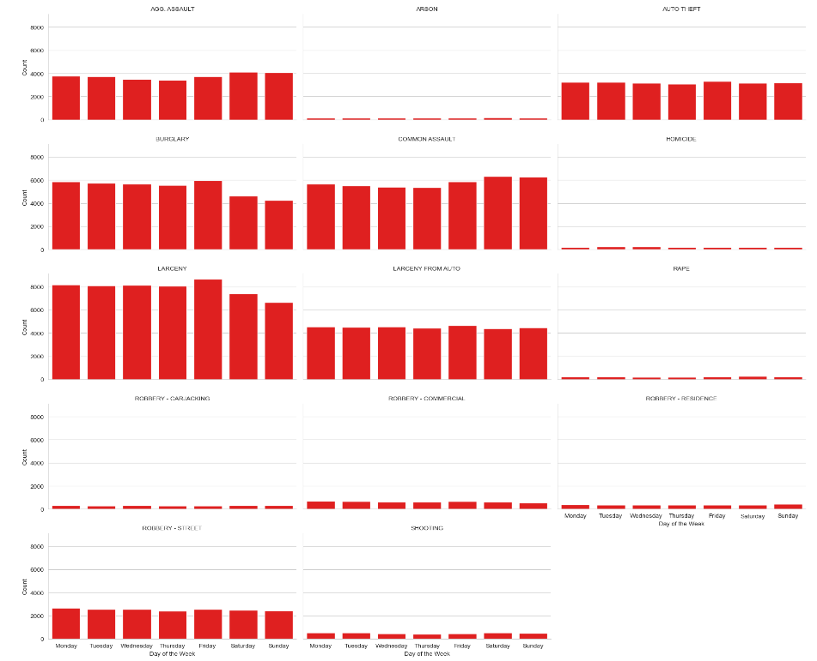
Crime Type day wise analysis

Slide 12
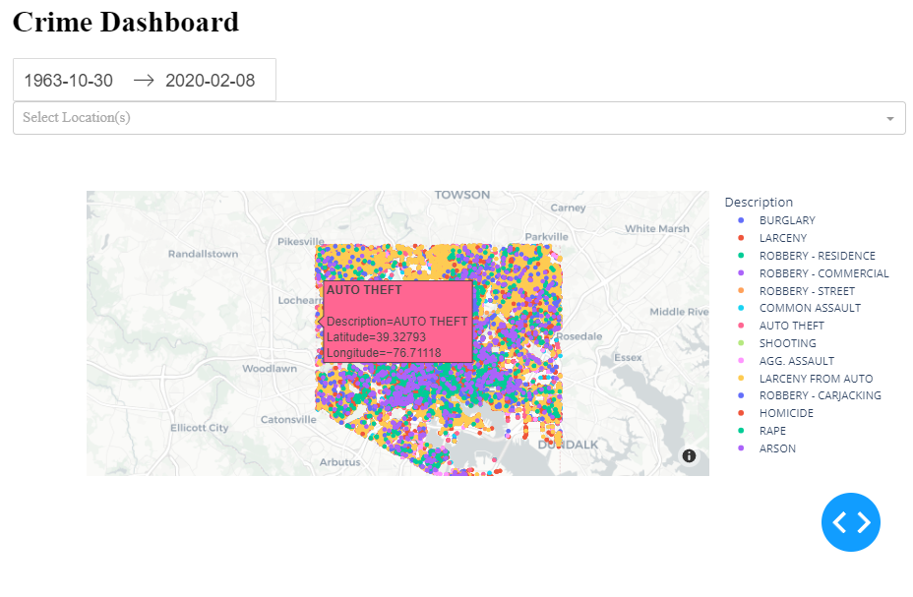
Crime Dashboard
The above dashboard implements selection of date, location. When you select a dot it give description, latitude and longitude.

Slide 13
Summary
Implemented data pre processing steps like converting data types, dropping unnecessary columns, drop null value rows.
Year 2016 has recorded the most no. of crime incidents.
Month October generally records the most no. of crime incidents whereas least recorded is the month February.
Friday records the most no. crime incidents.
Larceny is the most reported crime type whereas Arson is the least reported crime.
Analysed each crime type Yearly, Monthly and Weekly.
Implemented dashboard with Date and Location Selection and also give description when pointed to a dot.
Reflections Using ChatGPT
I have learnt to Seaborn module effectively for plotting graphs.
I have implemented Dashboard with help of ChatGPT.

